Slide 1
Different Methods of Presenting Poetry Multimodally and their Effects
By: Matt Jarrett

Slide 2
Introduction
Poetry has historically been a genre dictated by two forms, it is either read on the page, or heard spoken in a performance. With advances in technology, especially the web, it is now possible to take in poetry in a variety of multimodal ways that combine video, image, sound, and more. Modern poetry often crosses many modes or mediums, such as the aural, visual, gestural, etc. Here I have assembled a selection of multimodal poetry readings to better explain the new relationship poetry has with media.

Slide 3
Three Multimodal Poetry TEXTS
Chosen specifically to examine the ways in which they differ, I have selected three texts:
1. Maeva Ordaz’s 2015 PoetryOutLoud Championship reading of “Zacuanpapalotls” by Brenda Cárdenas
https://www.youtube.com/watch?v=fYfC625r1PE
2. A video slideshow prepared by Youtube user NightmareInMoloch paired with a reading of Allen Ginsberg’s “Sunflower Sutra”
https://www.youtube.com/watch?v=oVjMKMogTDY
3. Claudia Rankine’s audiovisual poetry play “Provenance of Beauty”
http://claudiarankine.com/

Slide 4
Features in Common
These videos vary greatly in how they present media that is at its core within the genre of spoken poetry, yet is complicated by videos presented alongside the poetry. These texts are multimodal due to their combining of gestural, aural, and visual modes. The authors of these spoken poems utilize the same techniques that result in genre conventions.
First of the genre conventions, all three of these texts utilize visual components paired with aural components (poetry). These visual components vary across each video, and in the case of Maeva Ordaz, result in gestural components being paired with visual ones. Secondly, great care is also taken by the performers to follow a specific aural pattern in their work.

Slide 5
Poetry Out Loud 2015 winner Maeva Ordaz
Maeva Ordaz recites the poem “Zacuanpapalotls” by Brenda Cárdenas for an audience at the 2015 PoetryOutLoud national competition.
Ordaz’ audience consists of everyone assembled to witness the performance, but is tailored to a rubric provided to judges who will score her performance across various categories. These categories include Physical Presence, Voice and Articulation, Dramatic Appropriateness, Evidence of Understanding, and Overall Performance.
The context of this reading being for the benefit of competition is extremely important as it preordains the goals or purpose of Ordaz’ reading. The end goal is to fulfill the demands of each of these categories to obtain the highest score.
Ordaz recites her choice of poetry in a very rehearsed performance that is done masterfully to provide strong accentuation during the moments of Hispanic influenced poetry. She also chooses to provide an alternating rhythm throughout her performance by increasing and decreasing the pace of her lines. Caesura or pause is also put to great use providing silence between line.

Slide 6
Maeva Ordaz’ Visual and Gestural Presence
The gestural, and thus visual, aspects of her reading compliment the aural aspects. The posture of the speaker remains the same so as to not be too distracting. Her hands often provide emphasis and demarcate the rhythms of her words. Body language indicates a reserved, respectful reading that wants to emphasize the sounds of the poem being read rather than the person on the stage.

Slide 7
Sunflower Sutra by Allen Ginsberg
A video crafted by Youtube user “NightmareInMoloch” intends to relate the spoken poetry of Allen Ginsberg in a unique way that capitalizes on the affordances a video slideshow allows for.
The audience of this text is likely any and all poetry enthusiasts or Ginsberg fans who are likely to want to hear a reading of this poem. This audience is likely sensitive to artistic and design choices, and in the context of viewing a video on Youtube may or may not judge heavily for poor craft. These viewers may completely disregard the visual aspect of the video, as they may have only been seeking to hear the reading.
Ginsberg reads his poem with his own distinctive voice that carries important usage of rhythm, caesura, emphasis, and typical deadpan voice. Ginsberg utilizes many of the same elements of craft Maeva Ordaz does in recitation, the only difference is that the poem was originally written in his voice.
Ginsberg’s purpose in reading his poetry is simply to relate poetry in his own authentic voice in a way that his audience may enjoy or empathize with.

Slide 8
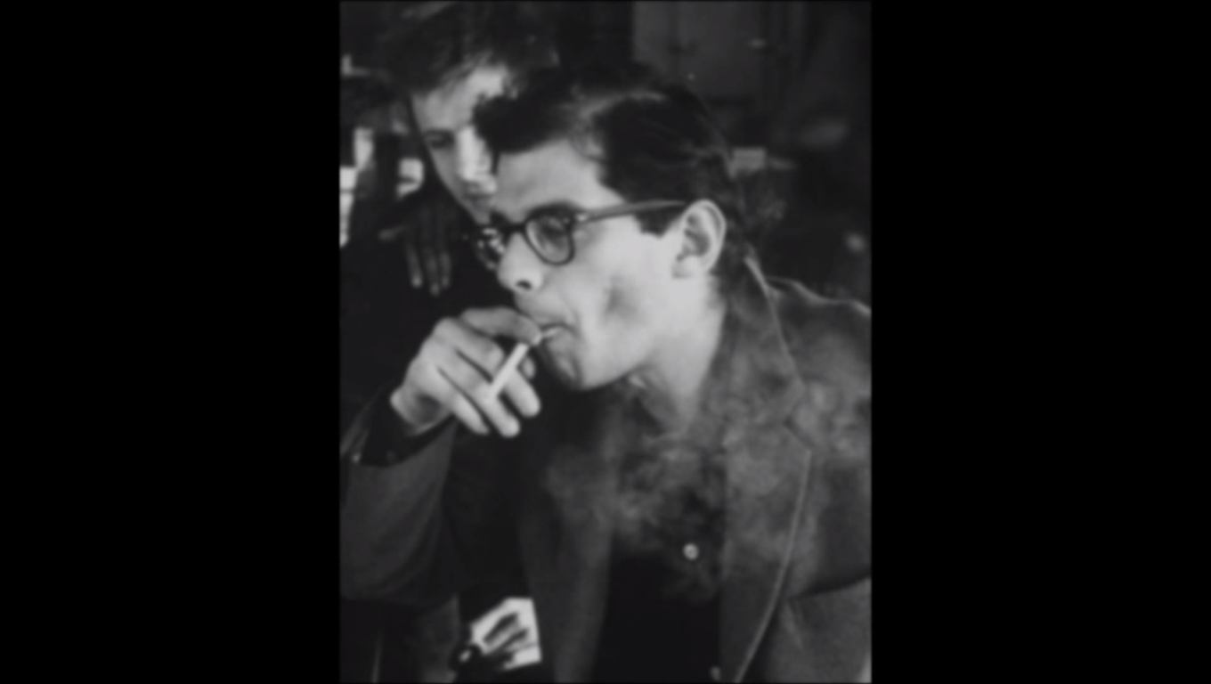
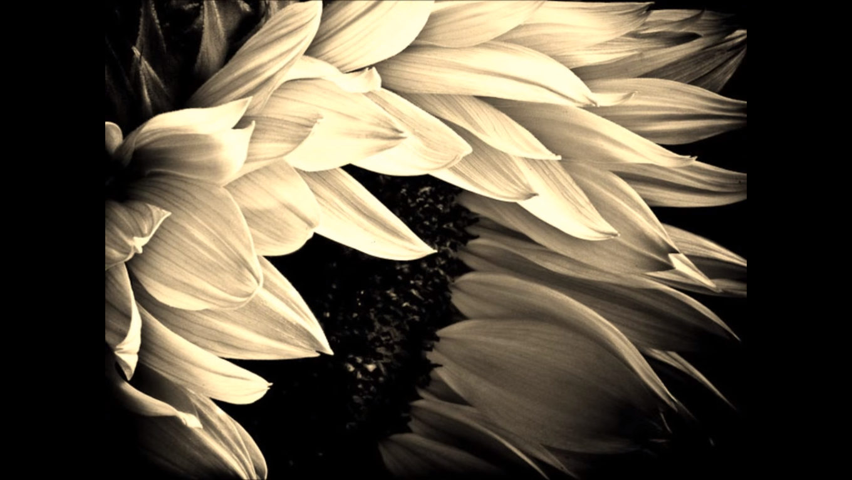
The aural aspect of this reading has been paired with images chosen to compliment the overall tone and content of the poem. These visuals also serve to invoke the sort of edginess and seediness promoted by beat poets. Visuals are chosen by relevance to the topic, cycling through portraits of Ginsberg and pictures of sunflowers. Just as in the other texts selected for this multimodal analysis, visual aspects are paired with aural aspects.

Slide 9
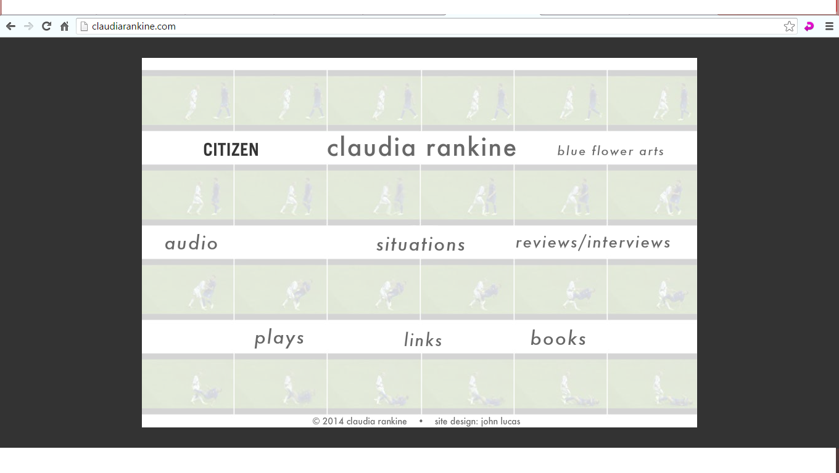
ClaudiaRankine.com
Claudia Rankine presents her work in a clean professional way through her personal website where she makes available works in many genres. Rankine’s audience is likely people already familiar with her work, or those who have heard of her and are interested. This audience includes people interested in art in all forms who are interested in Rankine’s goal of relating significant sensations and experiences to her audience through poetry.

Slide 10
The Provenance of Beauty by Claudia Rankine
The context and setting of Rankine’s work is important as well as it is simply a well-designed page on her website with little to distract or detract from the content of the video. The text chosen for analysis is her “Provenance of Beauty”, a so called “play” that pairs an aural reading of poetry with video. The purpose of this work is to pair the aural sensation of her poetry with a visual component that leads, much like the action of a play.

Slide 11
Purpose
Rankine has chosen to subvert the same principles the other readings choose to utilize. Rankine intends that the poem's sounds blend and meld into each other into a sort of single sound or song to the background of visuals. It is important that she refers to this reading as a "play", as the action and body language on stage is incredibly important. Rankine pairs seemingly very busy and mundane visuals with a poem in a way that would be distracting, as her purpose is to focus on the visual rather than the aural mode.
She performs her poem in spoken word to be more an accompaniment to the visuals, rather than the main text. This video differs in a more dramatic way than the others, but the core trait of visuals being paired with spoken poetry remains. The visuals could be construed as more distracting, but I believe this trait is an artistic choice made by Rankine.

Slide 12
Citations
Citations:
News, Alaska Dispatch. "Poetry Out Loud 2015 Winner Maeva Ordaz."YouTube. YouTube, 1 May 2015. Web. 26 Feb. 2016.
Moloch, Nightmare In. "Sunflower Sutra -- Allen Ginsberg." YouTube. YouTube, 18 Nov. 2010. Web. 26 Feb. 2016.
Rankine, Claudia. "Provenance of Beauty." Claudia Rankine Claudia Rankine, 18 Sept. 2009. Web. 26 Feb. 2016.

